Slide 1

BUDT 703_ 506_12 Team Project Moneyball Metrics
Team Members
Gunjan Suriya
Harish Bhupathiraju
Sai Devara
Solayappan Ganesaan
12/7/2023
Last edited: 12/7/2023

Slide 2
Background
The users would be the following
Analyst and Administrators :
Manages overall system configuration, user accounts, and database maintenance.
Coach and Players :
Accesses schedules and historical results.
Data Source:
https://umterps.com/sports/baseball/schedule

Slide 3
Introduction
Mission Statement
To study the Terrapin Men's Baseball Team's past games and assist team leadership and analysts in gaining insights into the team's competitiveness over the years by analyzing matches played against opponents across different venues and leagues.
Mission Objective
Find the ratio of game wins and losses based on home, away and neutral sites and identify the presence of a possible home-ground advantage.
Calculate the team’s average margin of wins (or losses) to understand the intricate improvements in offense or defense across the years.
Find out the team’s performance in BigTen conference over the years.
Evaluate the team’s performance by opponents to identify historically tough opponents.
Identify the states where our team traditionally performed well versus not to prepare better for tough travels.
Visualize the winning or losing game streaks over the years to identify historical records and influence team psychology.

Slide 4
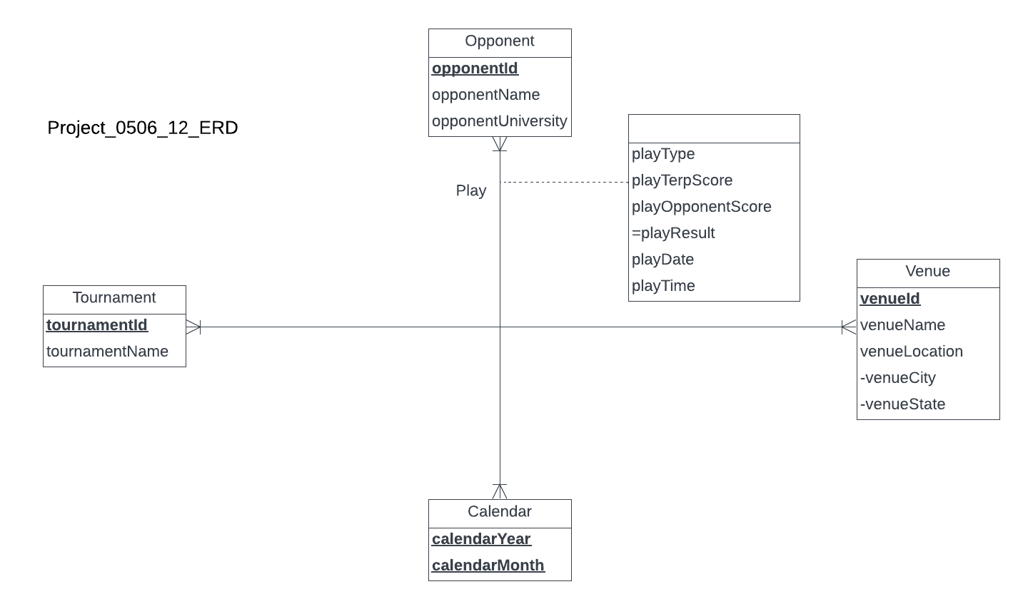
ER Diagram
The Entities are as follows Opponent Tournament Calendar Venue All of them are linked together by a 4th degree one to many relation with the following attributes: Play type, the scores, the Date and the time
Conceptual Database Design

Slide 5
Logical Database Design
Opponent(opponentId, opponentName, opponentUniversity) Tournament (tournamentId, tournamentName) Calendar (calendarMonth, calendarYear) Venue (venueId, venueName, venueCity, venueState) Play (playTime, playDate, calendarMonth, calenderYear, opponentId, tournamentId, venueId, playType, playTerpScore, playOpponentScore)

Slide 6
CREATE Table
Opponent -
CREATE TABLE [Moneyball.Opponent] (
opponentId CHAR(4) NOT NULL,
opponentName VARCHAR(50),
opponentUniversity VARCHAR(99),
CONSTRAINT pk_Opponent_opponentId PRIMARY KEY (opponentId)
);
CREATE TABLE [Moneyball.Tournament] (
tournamentId CHAR(3) NOT NULL,
tournamentName VARCHAR (50),
CONSTRAINT pk_Tournament_tournamentId PRIMARY KEY (tournamentId)
);
Tournament -
Physical Database Design

Slide 7
CREATE Table
Calendar -
CREATE TABLE [Moneyball.Calendar](
calendarMonth CHAR(3) NOT NULL,
calendarYear DATE NOT NULL,
CONSTRAINT pk_Calendar_calendarYear_calendarMonth PRIMARY KEY (calendarYear, calendarMonth)
);
CREATE TABLE [Moneyball.Venue](
venueId CHAR(5) NOT NULL,
venueName VARCHAR(50),
venueCity VARCHAR(50),
venueState CHAR(2),
CONSTRAINT pk_Venue_venueId PRIMARY KEY (venueId)
);
Venue -
Physical Database Design

Slide 8
CREATE Table
Play -
CREATE TABLE [Moneyball.Play](
opponentId CHAR(4) NOT NULL,
tournamentId CHAR(3) NOT NULL,
calendarYear DATE,
calendarMonth CHAR(3) NOT NULL,
venueId CHAR(5) NOT NULL,
playType VARCHAR(10),
playTerpScore INT,
playOpponentScore INT,
playDate INT NOT NULL,
playTime CHAR(8),
CONSTRAINT pk_Play_calendarYear_calendarMonth_playDate_playTime PRIMARY KEY (calendarYear, calendarMonth, playDate, playTime),
CONSTRAINT fk_Play_opponentId FOREIGN KEY (opponentId)
REFERENCES [Moneyball.Opponent](opponentId)
ON DELETE NO ACTION ON UPDATE CASCADE,
CONSTRAINT fk_Play_tournamentId FOREIGN KEY (tournamentId)
REFERENCES [Moneyball.Tournament](tournamentId)
ON DELETE NO ACTION ON UPDATE CASCADE,
CONSTRAINT fk_Play_calendarYear_calendarMonth FOREIGN KEY (calendarYear, calendarMonth)
REFERENCES [Moneyball.calendar](calendarYear, calendarMonth)
ON DELETE NO ACTION ON UPDATE CASCADE,
CONSTRAINT fk_Play_venueId FOREIGN KEY (venueId)
REFERENCES [Moneyball.Venue](venueId)
ON DELETE NO ACTION ON UPDATE CASCADE);
Physical Database Design

Slide 9
Transaction 1
What is the ratio of game wins based on home, away, and neutral sites?

Slide 10
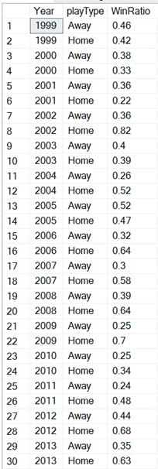
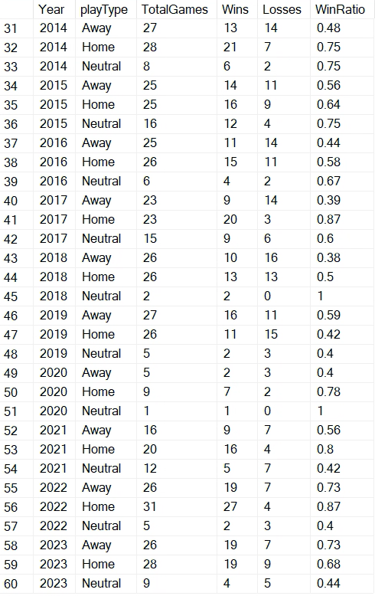
SQL
SELECT YEAR(p.calendarYear) as 'Year', p.playType AS 'Play Type’, ROUND(CAST(SUM(CASE WHEN playResult = 'W' THEN 1 ELSE 0 END) AS FLOAT) / COUNT(*), 2) AS WinRatio
FROM [Moneyball.Play] p
GROUP BY p.playType,YEAR(p.calendarYear)
ORDER BY YEAR(p.calendarYear);
SQL Output

Slide 11
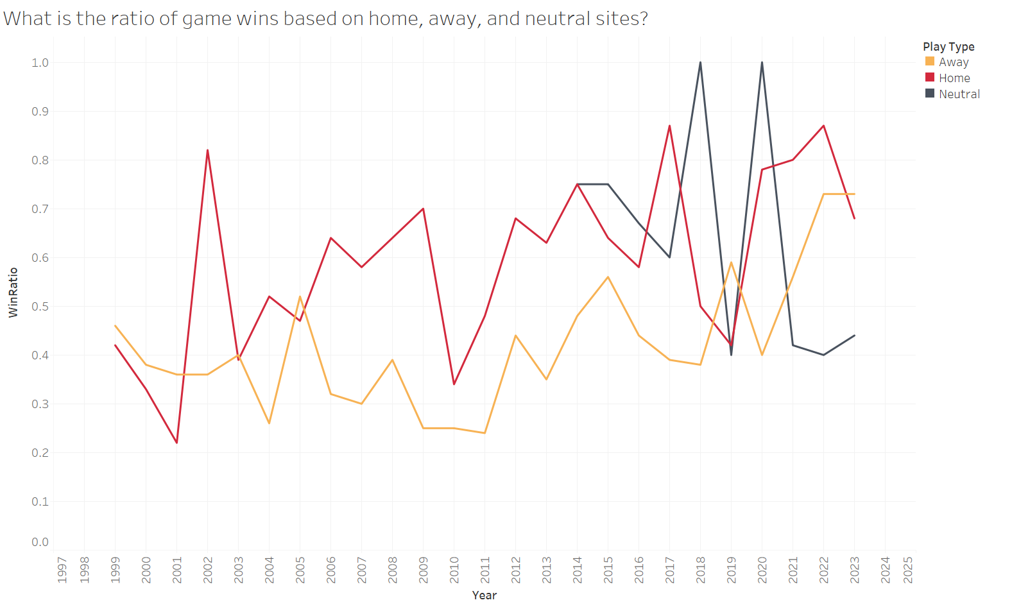
What is the ratio of game wins based on home, away, and neutral sites?

Slide 12
Transaction 2
What is the team’s average margin of wins and losses in the previous years?

Slide 13
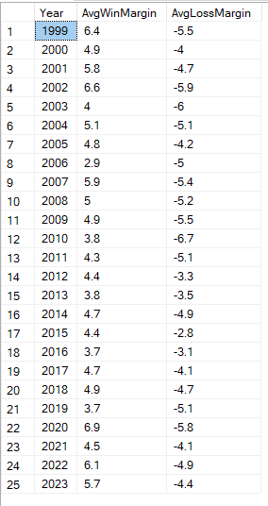
SQL
SELECT YEAR(calendarYear) as 'Year',
ROUND(AVG(CASE WHEN playresult = 'W' THEN CAST(playTerpScore – playOpponentScore AS FLOAT) ELSE NULL END),1) AS AvgWinMargin,
ROUND(AVG(CASE WHEN playresult = 'L' THEN CAST(playTerpScore - playOpponentScore AS FLOAT) ELSE NULL END),1) AS AvgLossMargin
FROM [Moneyball.Play]
GROUP BY YEAR(calendarYear)
ORDER BY YEAR(calendarYear);
SQL Output

Slide 14
Why not Run differential?
Season | Game | TerpScore | OppScore
1 | 1 | 2 | 1
1 | 2 | 2 | 5
2 | 1 | 1 | 2
2 | 2 | 1 | 2
Run differential:
Season1: -2
Season2: -2
AvgLossMargin:
Season1: -3
Season2: -1
AvgWinMargin:
Season1: 1
Season2: 0
Notes:
The metrics of AvgLossMargin, Avgwinmargin helps understand the improvement in defense and offense intricately than the run differential metric
When there are 2 matches played last season and if the scores in favor of us are 2-1, 2-5 , run differential is -2. if the results this year are 1-2,1-2, run differential is -2 while the Avg Loss Margin in the two years are -3,-1 while Avg Win margin is 1,0
AvgWinMargin and AvgLossMargin can help measure the intricate improvement in Defense and offense over seasons to a better degree

Slide 15
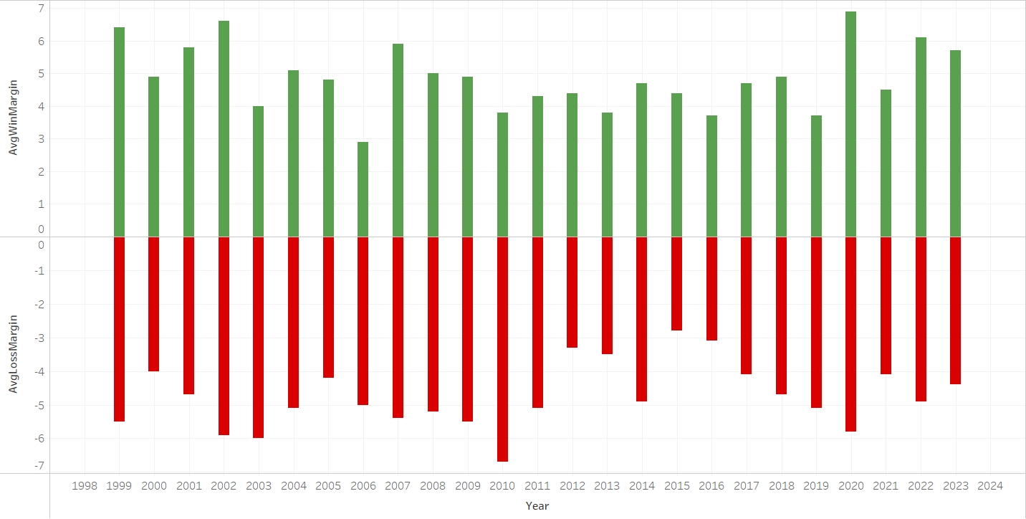
What is the team’s average margin of wins and losses in the previous years?

Slide 16
Transaction 3
What is the ratio of game wins in Big Ten conference games?

Slide 17
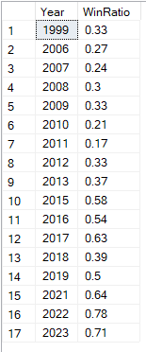
SQL
SELECT YEAR(p.calendarYear) as 'Year',
ROUND(CAST(SUM(CASE WHEN playResult = 'W' THEN 1 ELSE 0 END) AS FLOAT) / COUNT(*), 2) AS WinRatio
FROM [Moneyball.Play] p, [Moneyball.Tournament] t
WHERE p.tournamentId = t.tournamentId AND t.tournamentName = 'Big Ten'
GROUP BY t.tournamentName, YEAR(p.calendarYear)
ORDER BY YEAR(p.calendarYear);
SQL Output

Slide 18
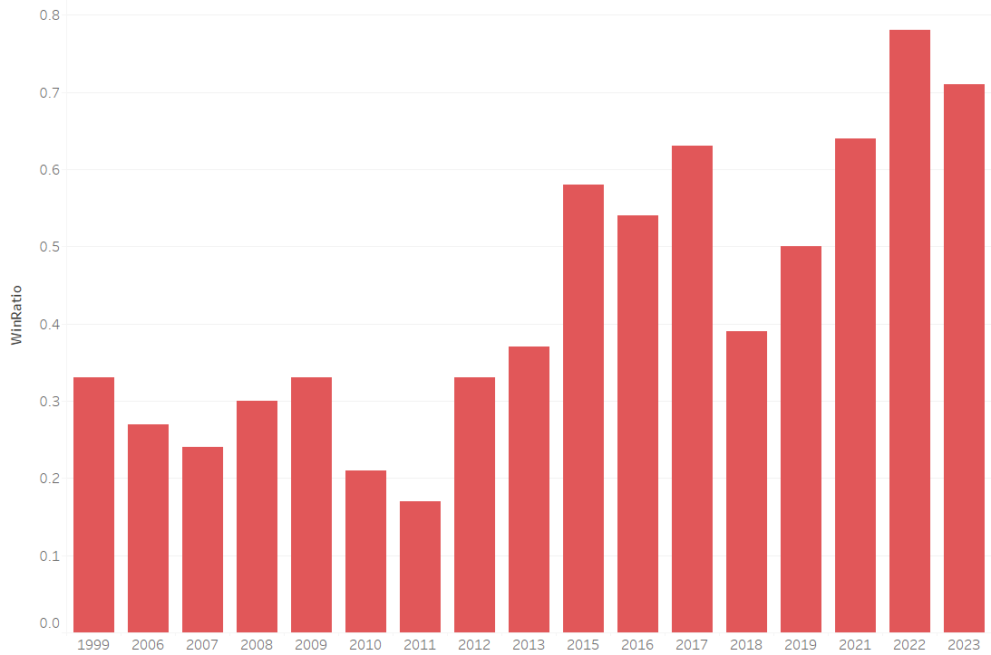
What is the ratio of game wins in Big Ten conference games?

Slide 19
Transaction 4
What is the team’s Winning rate against opponents where atleast 10 games being played?

Slide 20
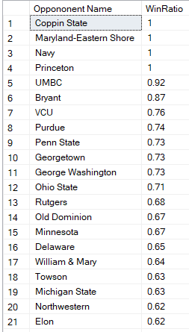
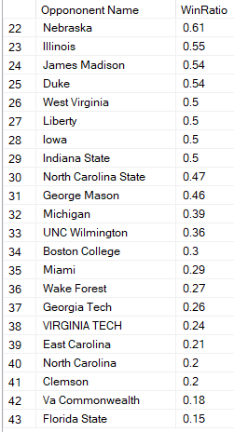
SQL
SELECT o.opponentName AS 'Oppononent Name',
ROUND(CAST(SUM(CASE WHEN p.playResult = 'W' THEN 1 ELSE 0 END) AS FLOAT) / COUNT(*), 2) AS WinRatio
FROM [Moneyball.Play] p
JOIN [Moneyball.Opponent] o ON p.opponentId = o.opponentId
GROUP BY p.opponentId, o.opponentName
HAVING COUNT(*)>=10
ORDER BY WinRatio DESC;
SQL Output

Slide 21
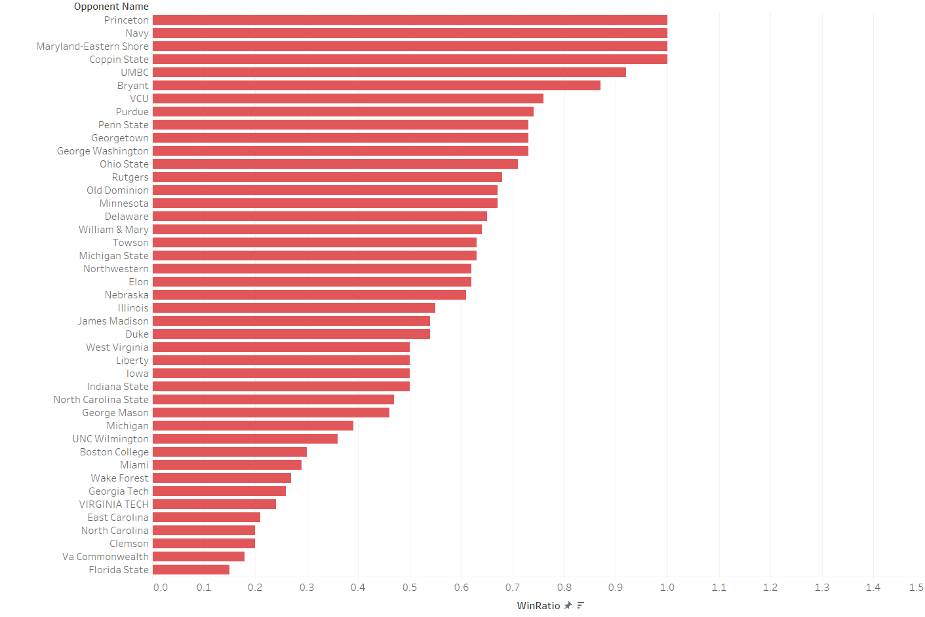
What is the team’s Winning rate against opponents where atleast 10 games being played?

Slide 22
Transaction 5
What is the win ratio over the years across different States?

Slide 23
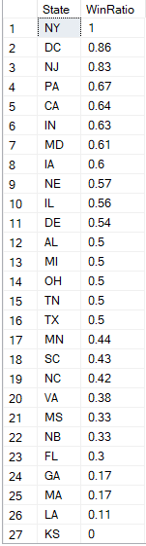
SQL
SELECT v.venueState AS 'State',
ROUND(CAST(SUM(CASE WHEN p.playResult = 'W' THEN 1 ELSE 0 END) AS FLOAT) / COUNT(*), 2) AS WinRatio
FROM [Moneyball.Play] p, [Moneyball.Venue] v
WHERE p.venueId = v.venueId
GROUP BY v.venueState
Order BY WinRatio DESC;
SQL Output

Slide 24
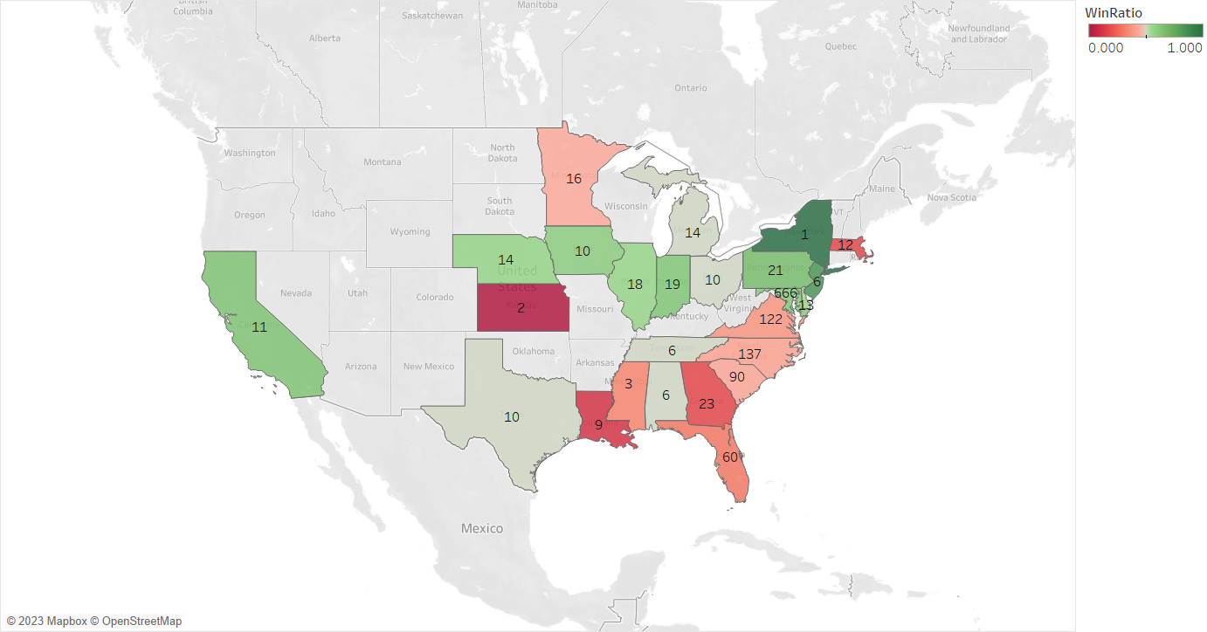
What is the team’s Winning rate against opponents where atleast 10 games being played?

Slide 25
Tableau Dashboard

Slide 26
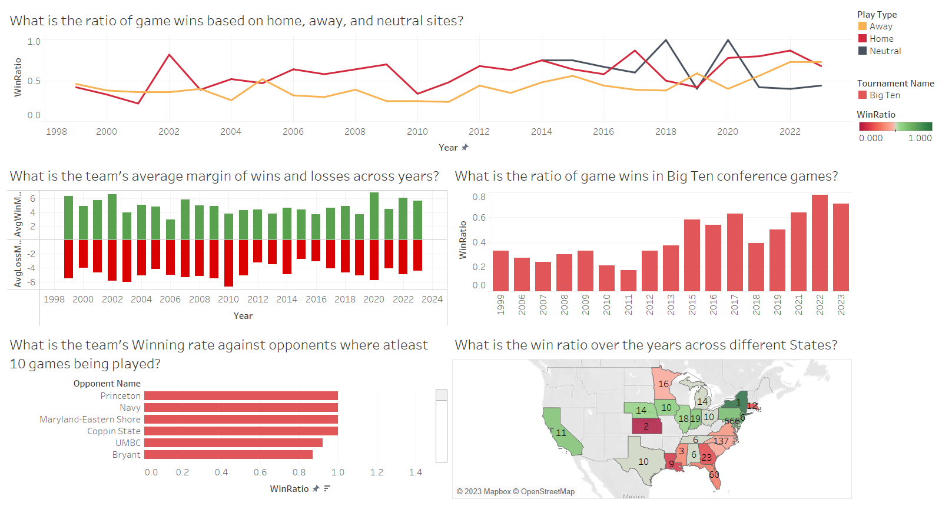
Game Result analysis

Slide 27

Facts and Figures
1315 Games with results in 25 Years
Home Or Away? game is not always determined by the stadium where the match is played
175 Venues reduced to
99 Unique Venues post data clean up
213 Opponents reduced to
145 Unique Opponents post data clean up
Identification of double headers leading to time also being used as a primary key
Worried about not having Venue and Tournament details for a game, We got you covered

Slide 28


